Slide 1
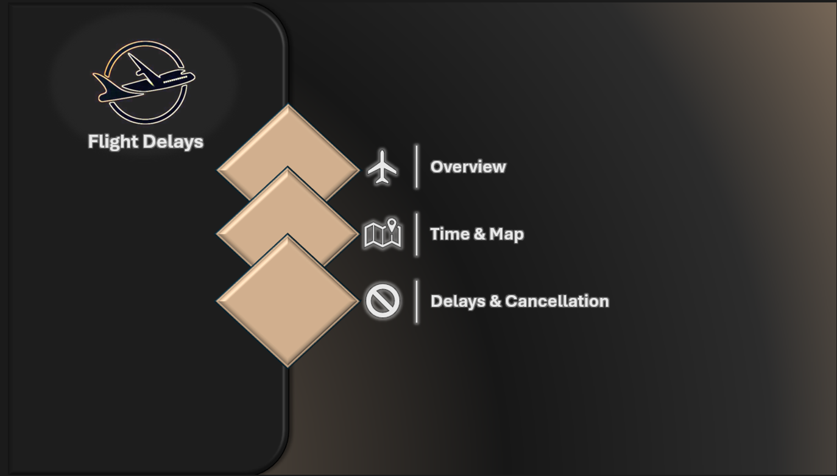

Slide 2

Overview
This report presents an analysis of flight delays in 2015, focusing on identifying key trends and delay factors. The visualizations are designed to provide understanding of the causes of delays, the impact on different airports, and airline performance, offering insights to improve operational efficiency.

Slide 3
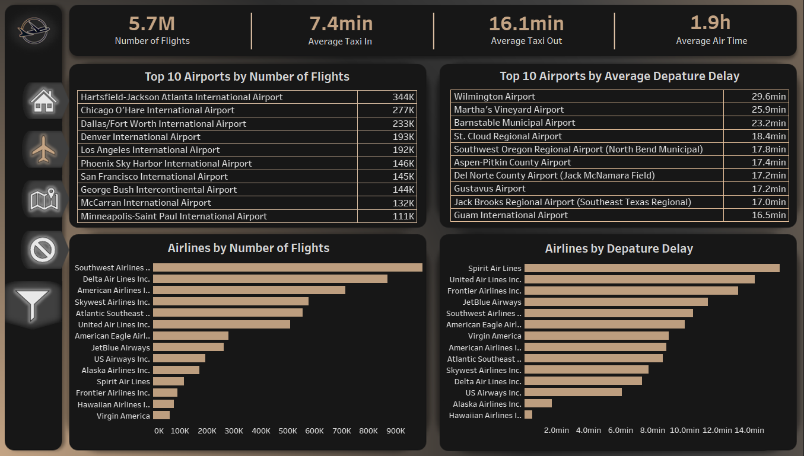

Slide 4

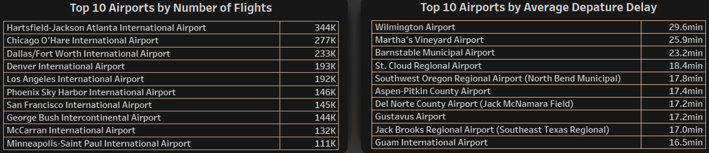
These Cards are used to give an overview of the flight delays dataset in terms of Number of Flights, Average Taxi in & out, and the Average Airtime.
The two tables are used to give an overview on the top 10 Airports in terms of Number of flights and Depature Delay

Slide 5
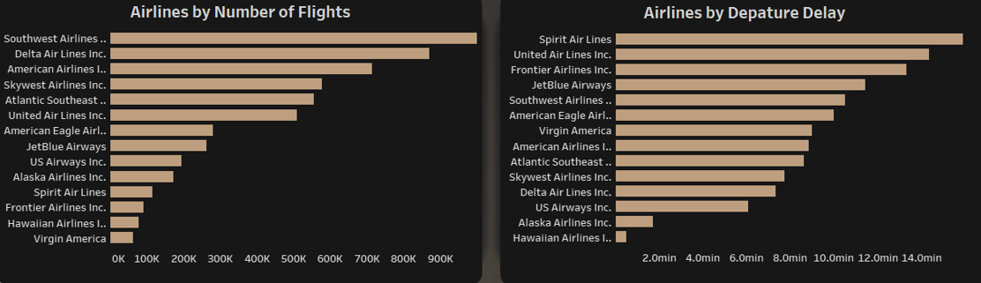
These Column charts are used to give an overview of the Airlines in terms of Number of flights and Depature Delay

Slide 6
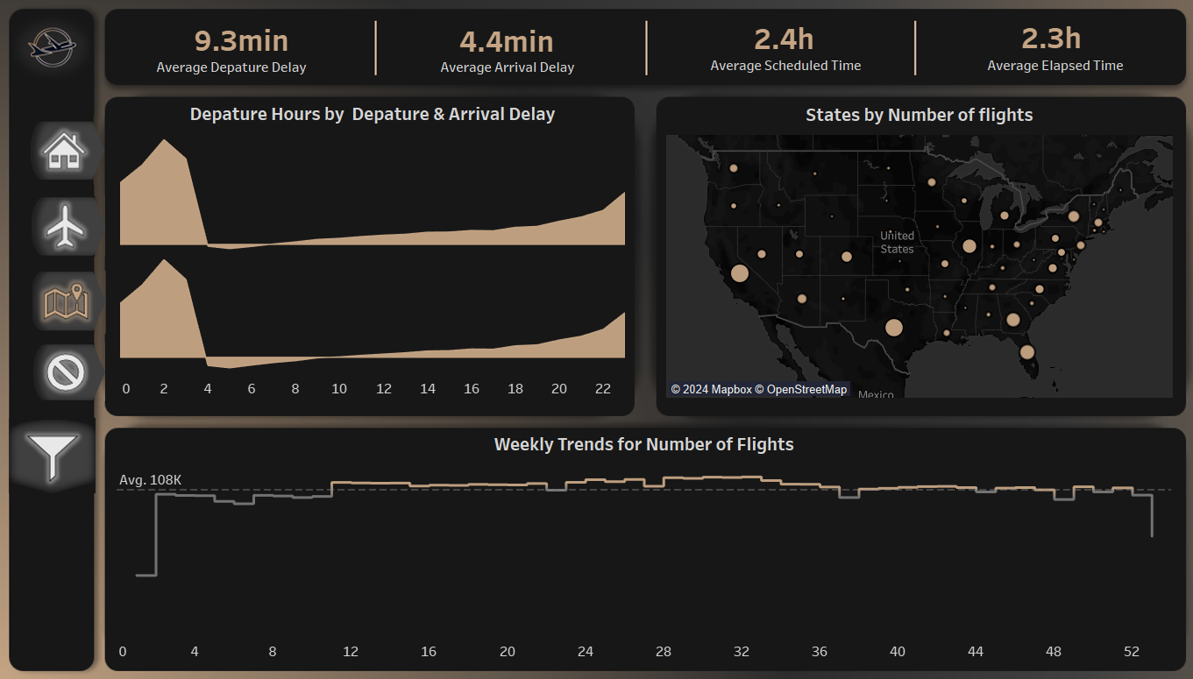

Slide 7
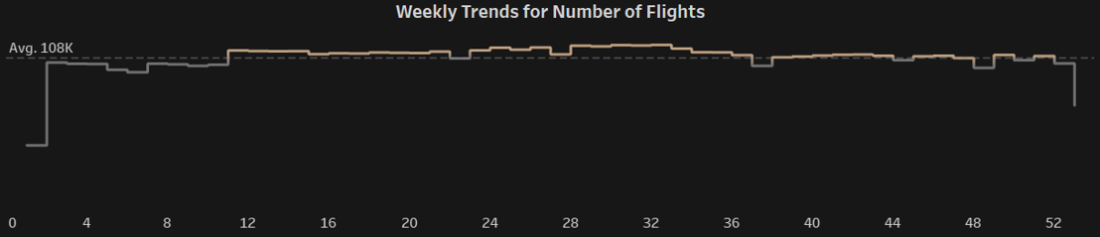
These Cards are used to give an overview of the flight delays dataset in terms of Average Depature & Arrival Delay, and Average Scheduled & Elapsed Time.
This line chart tracks weekly number of flights across 2015 showing the ups and downs throughout the whole year and whether it’s above or below the average number of flights

Slide 8
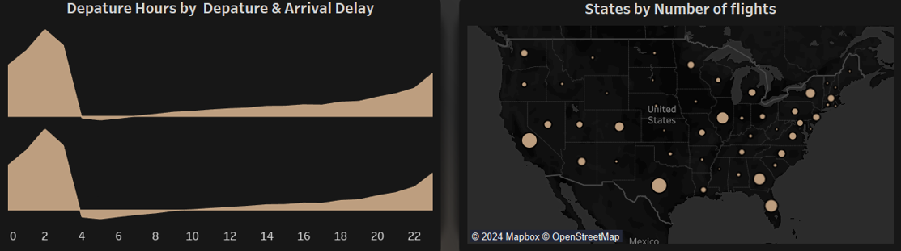
The area chart is used to give insights about the Depature and Arrival Delay across the depature day hours.
The map used to give an overview on the number of flights for each state.

Slide 9
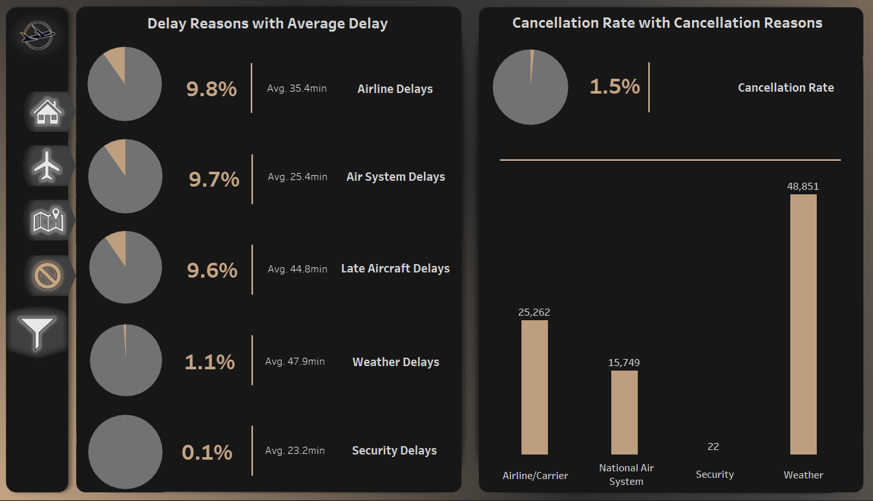

Slide 10
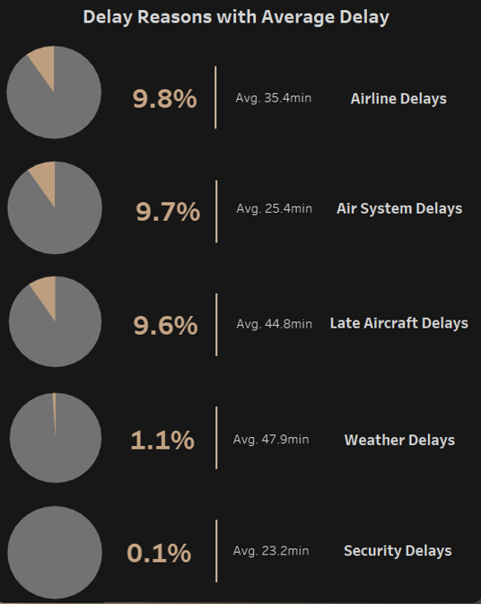
This shape displays pie charts presenting the percentage with its average time of each delay reason, highlighting both the most and least common reasons of delays, allowing to focus on minimizing them.

Slide 11
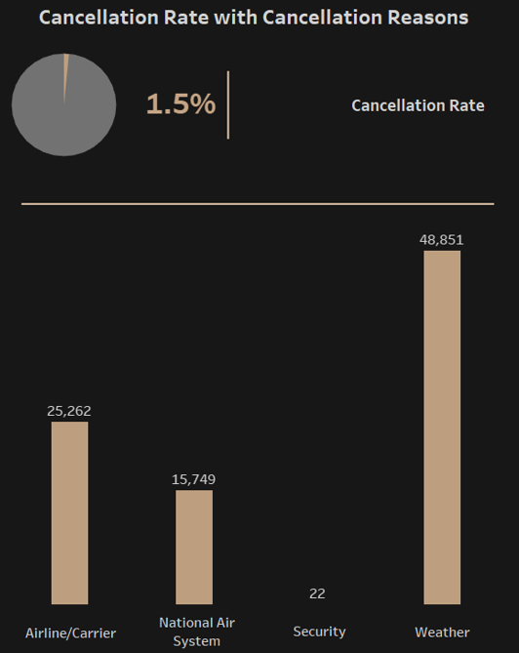
This shape displays the cancellation rate with an overview from the most to the least common cancellation reason.

